Slide 1


Introduction to Operating Systems CS 1550
Spring 2023
Sherif Khattab
ksm73@pitt.edu
(Some slides are from Silberschatz, Galvin and Gagne ©2013)

Slide 2
Announcements
Upcoming deadlines:
Homework 10: due on 4/11
Project 3: due on 4/11
Lab 4: due on 4/15

Slide 3
Previous lecture …
How to allocate disk blocks to files and directories?
contiguous and linked

Slide 4
Muddiest Points (Memory)
Is the reference bit initially set to 0 or 1 after a page is loaded into memory following a page fault?
Page locking
Unclear on how to use valid bit to indicate page fault. Is that because valid bit == 0 means the data at this address is invalid, so we need to fetch a valid data from disk?

Slide 5
Muddiest Points (File System)
Not sure what the numbers in the FAT cells represent?
Is it better to the int next_block at the beginning or end of the structure?
offset calculation was a little quick, can we review it
Logical to physical mapping calculation
Are block sizes all the same when using linked allocation?
What allocation method is used most commonly in modern OS's?

Slide 6
Muddiest Points (Project 3)
Would you please explain about project 3?

Slide 7
Problem of the Day
How to allocate disk blocks to files and directories?

Slide 8
File Allocation Table (FAT)
Links on disk are slow
Keep linked list in memory
Advantage: faster
Disadvantages
Have to copy it to disk at some point
Have to keep in-memory and on-disk copy consistent
0
4
1
-1
2
-1
3
-2
4
-2
5
-1
6
3
B
7
-1
8
-1
9
0
A
10
-1
11
-1
12
-1
13
-1
14
-1
15
-1

Slide 9
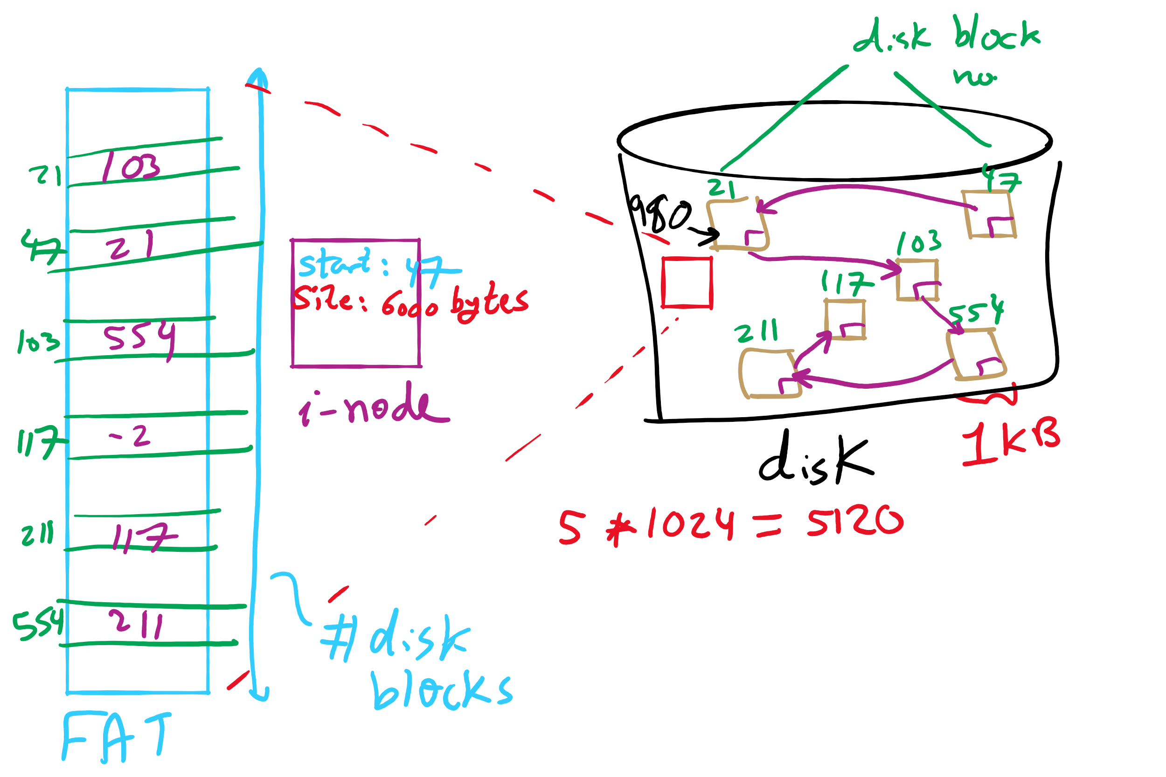
FAT Example

Slide 10
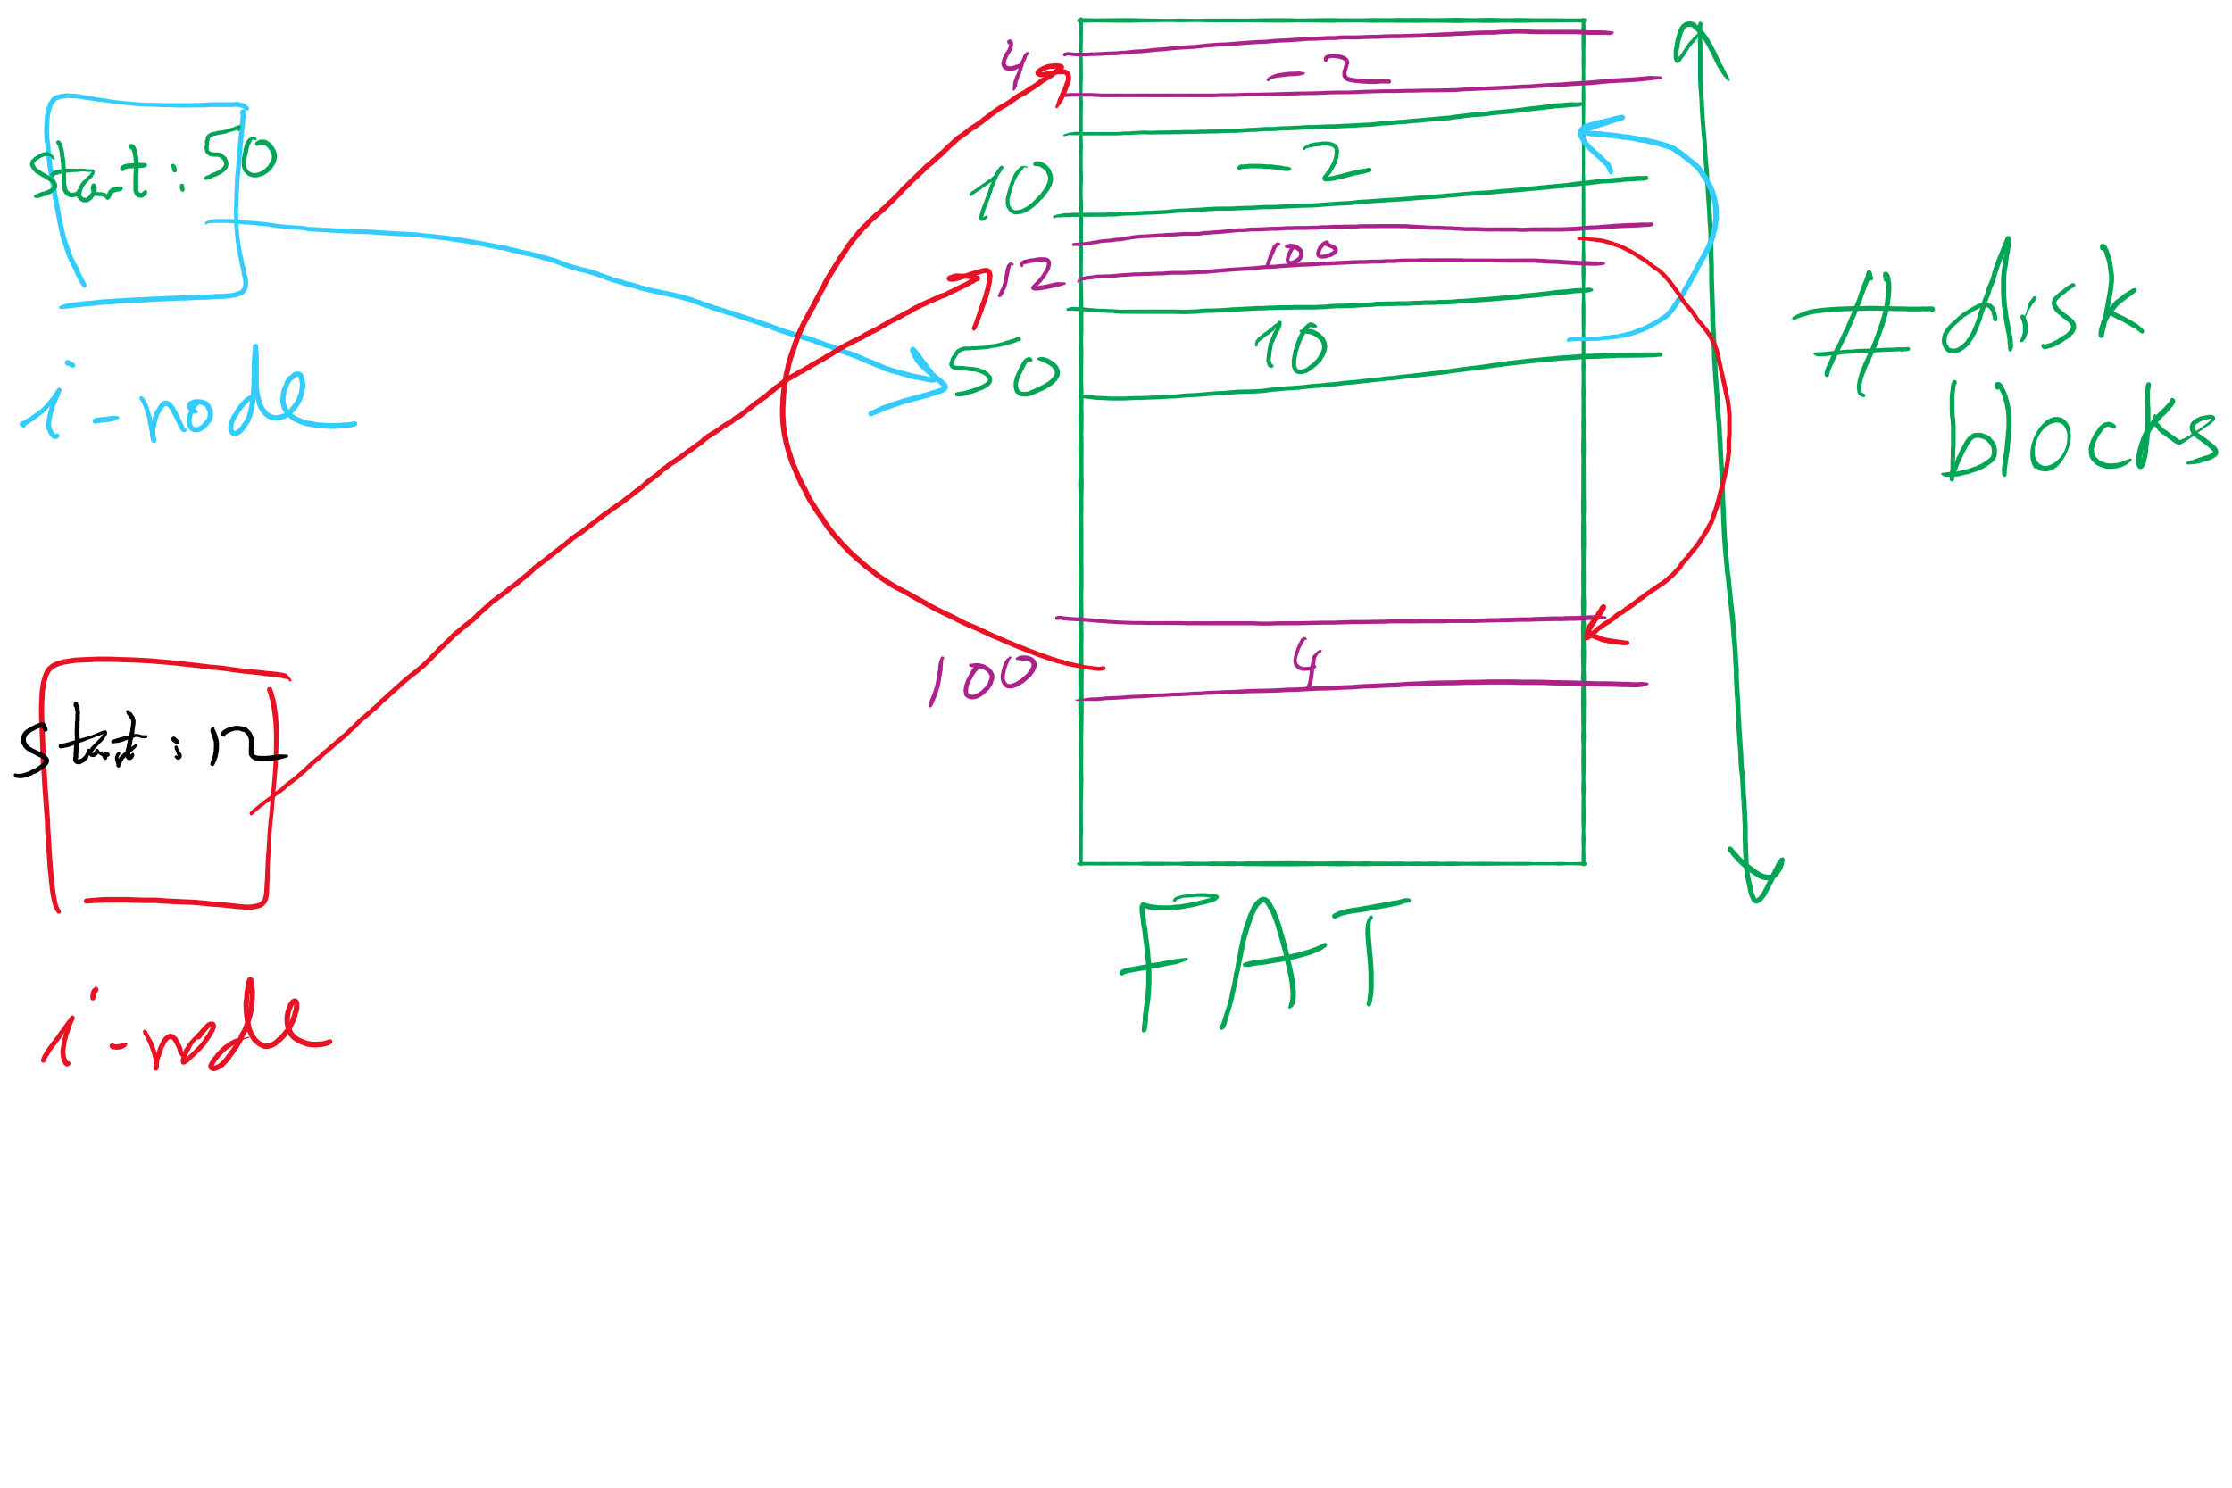
i-node and FAT

Slide 11
Using a block index for allocation
Store file block addresses in an array
Array itself is stored in a disk block
Directory has a pointer to this disk block
Non-existent blocks indicated by -1
Random access easy
Limit on file size?
Name index size
grades 4 4802
0
1
2
3
6
9
7
0
8
4
5
6
7
8
9
10
11

Slide 12
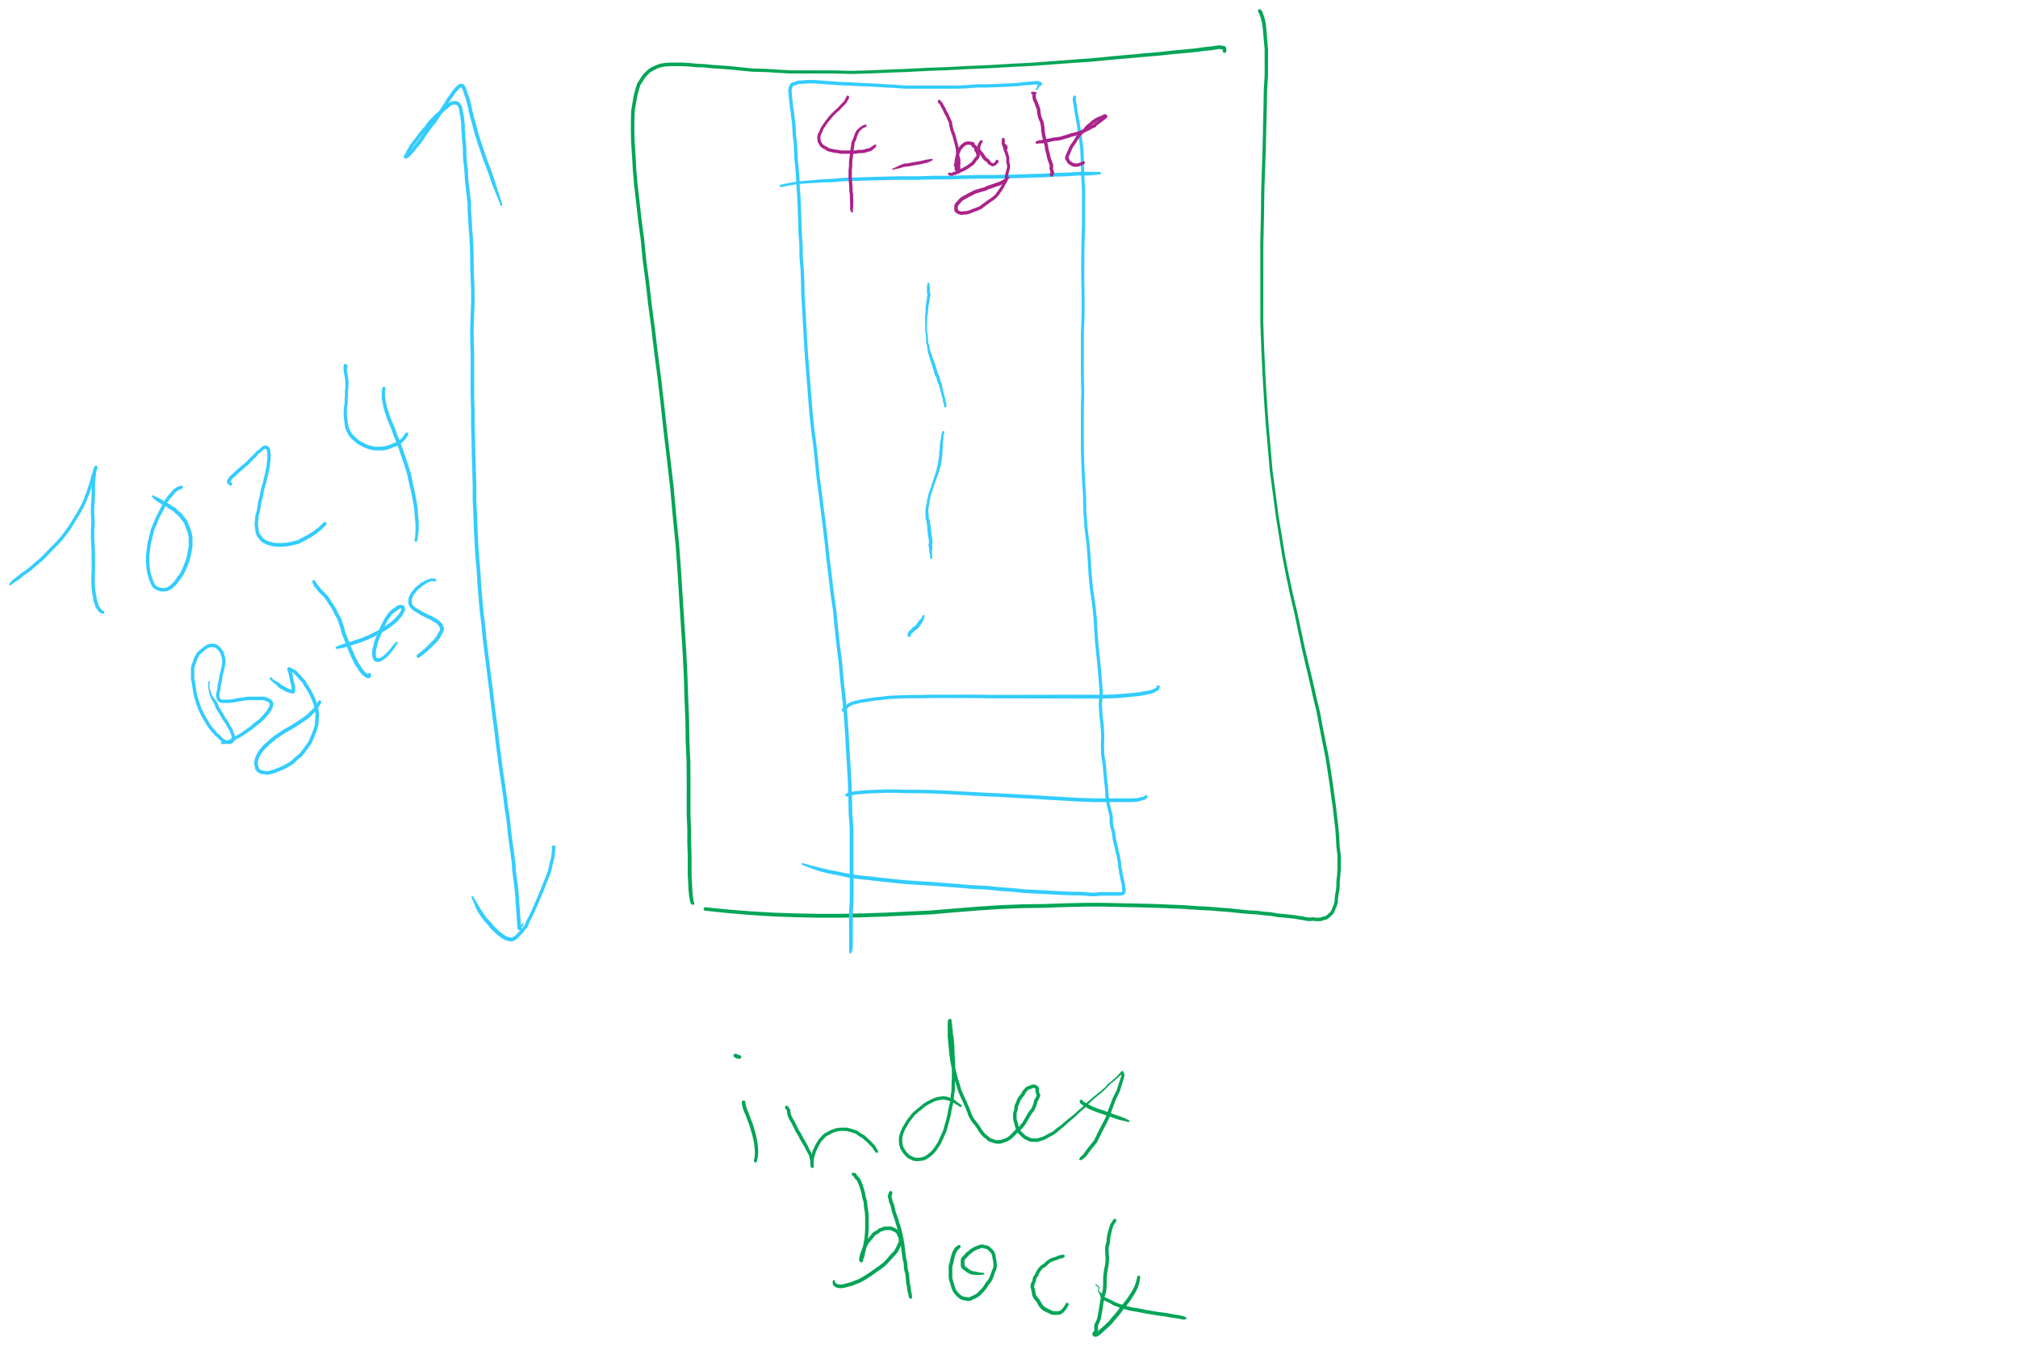
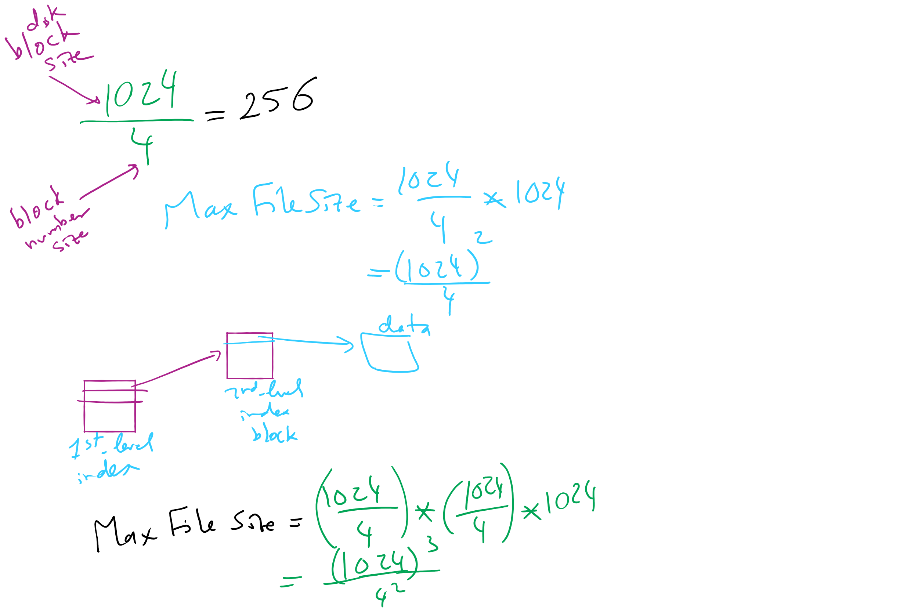
Max File Size for Indexed Allocation

Slide 13
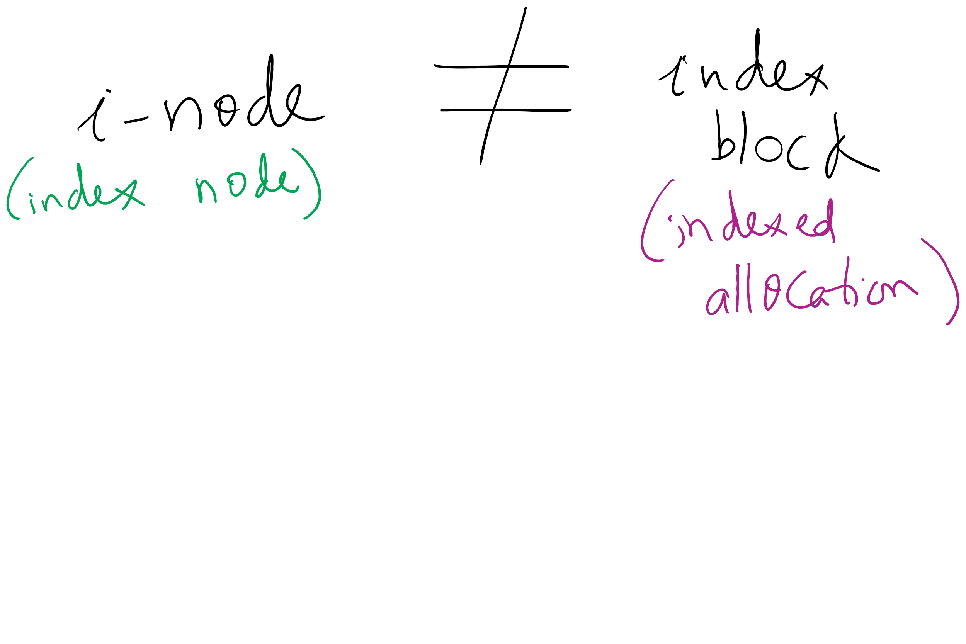
i-node vs index block

Slide 14
Unix Fast File System indexing scheme
protection mode
data
owner & group
data
.
.
.
timestamps
size
data
block count
•
data
•
.
.
.
link count
•
Direct pointers
.
.
.
data
•
•
•
data
•
.
.
.
•
•
single indirect
•
•
data
double indirect
•
•
data
•
•
•
•
.
.
.
triple indirect
•
•
•
inode
•
•
•
data

Slide 15
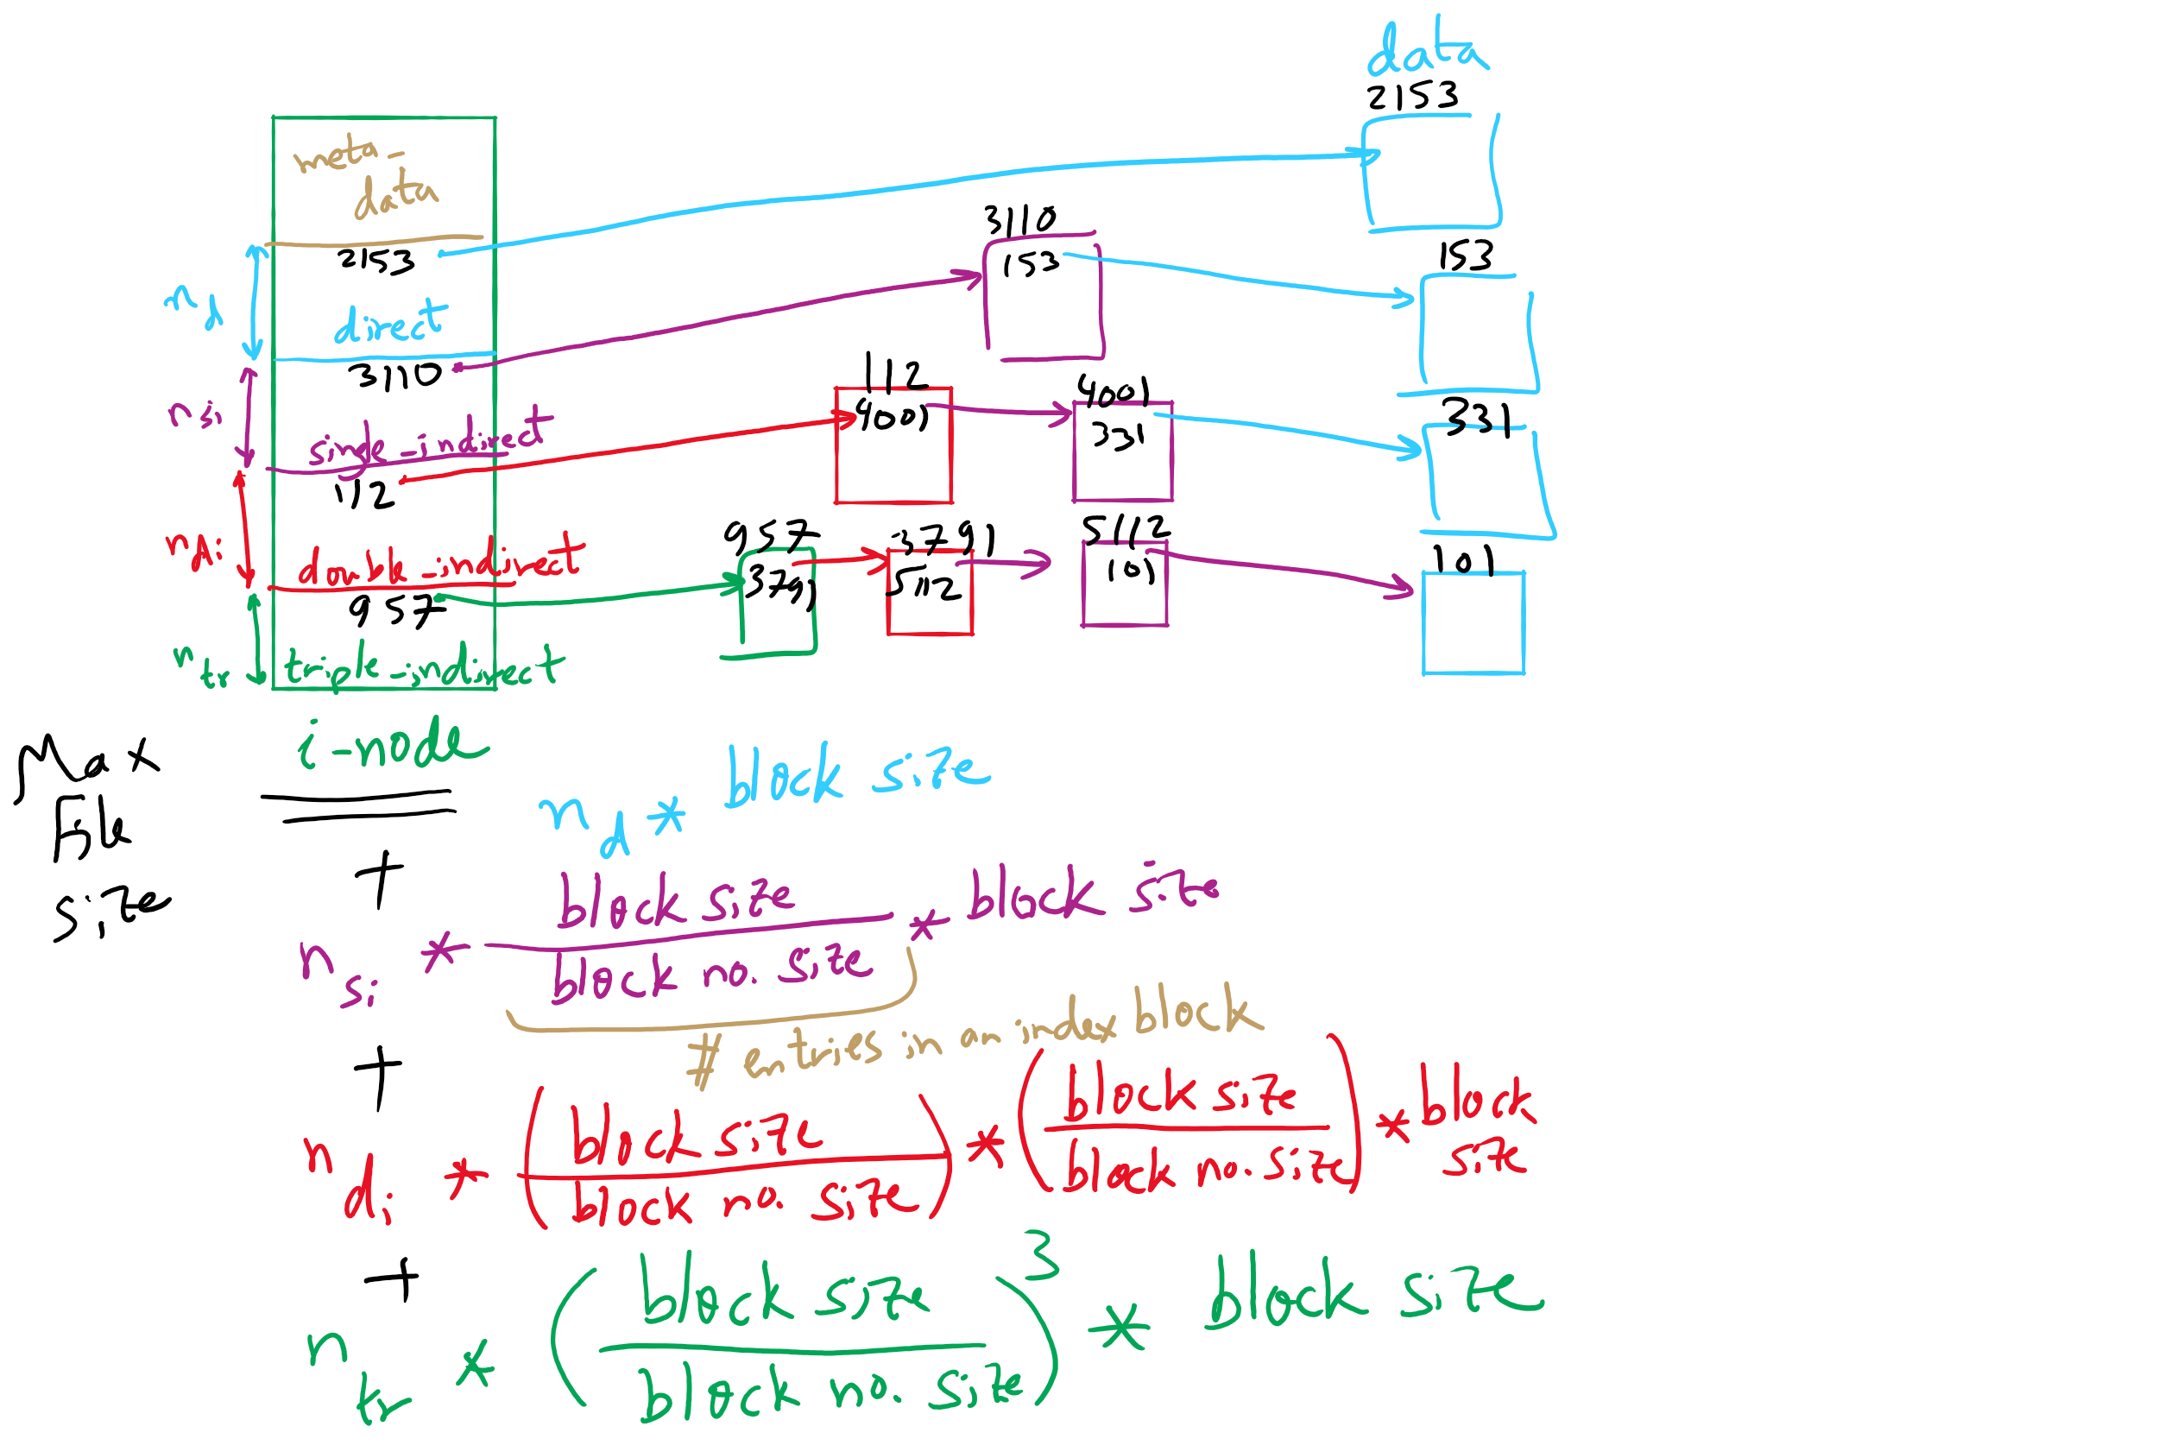
FFS and Max File Size

Slide 16
What’s in a directory?
Two types of information
File names
File metadata (size, timestamps, etc.)
Basic choices for directory information
Store all information in directory
Fixed size entries
Disk addresses and attributes in directory entry
Store names & pointers to index nodes (i-nodes)
attributes
games
attributes
games
mail
attributes
mail
attributes
news
attributes
news
attributes
research
attributes
research
Storing all information in the directory
Using pointers to index nodes
attributes

Slide 17
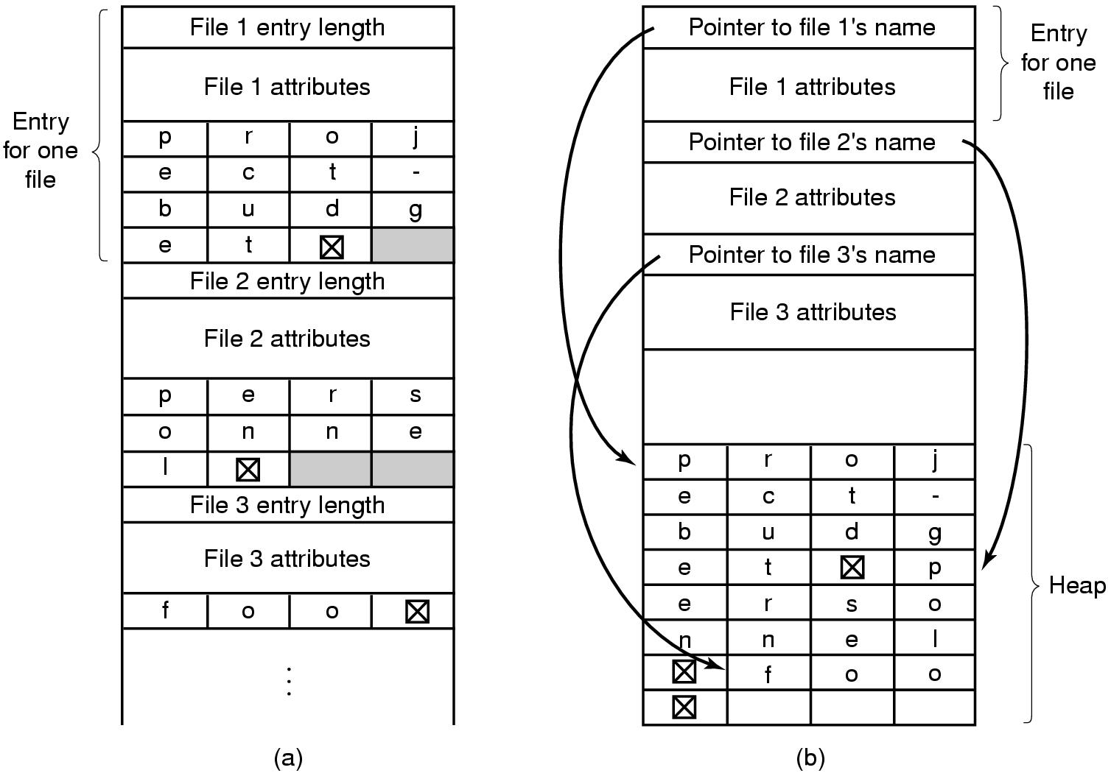
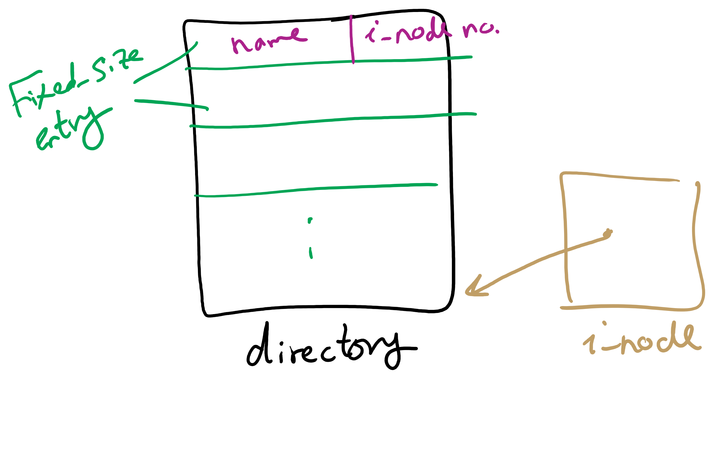
Handling long file names in a directory

Slide 18
Free Block Tracking
10

Slide 19
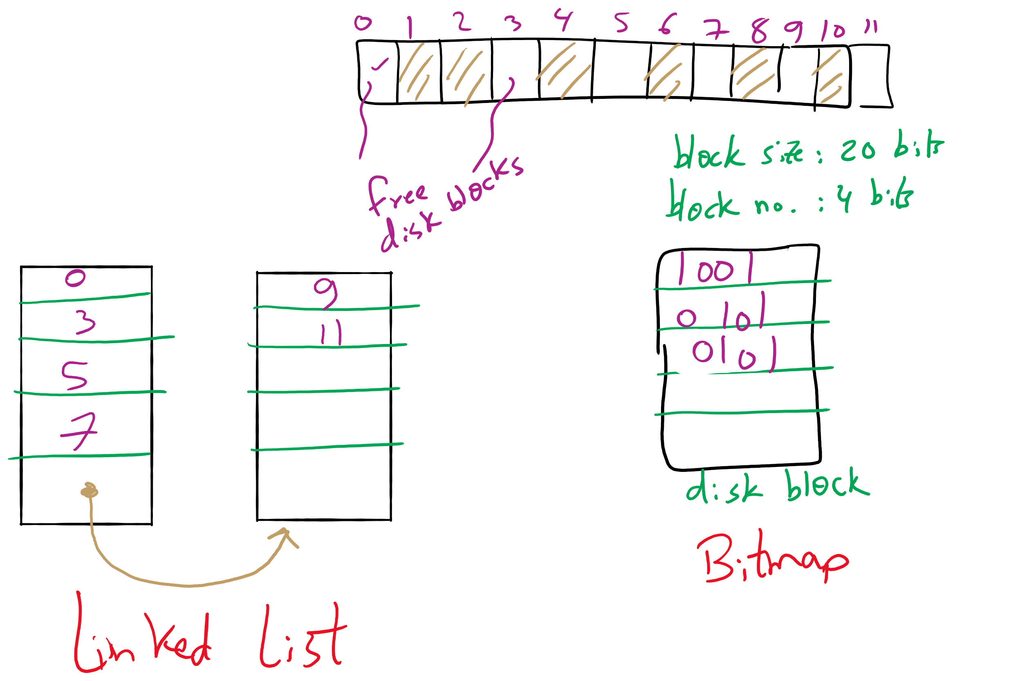
Free Block Tracking Example 1

Slide 20
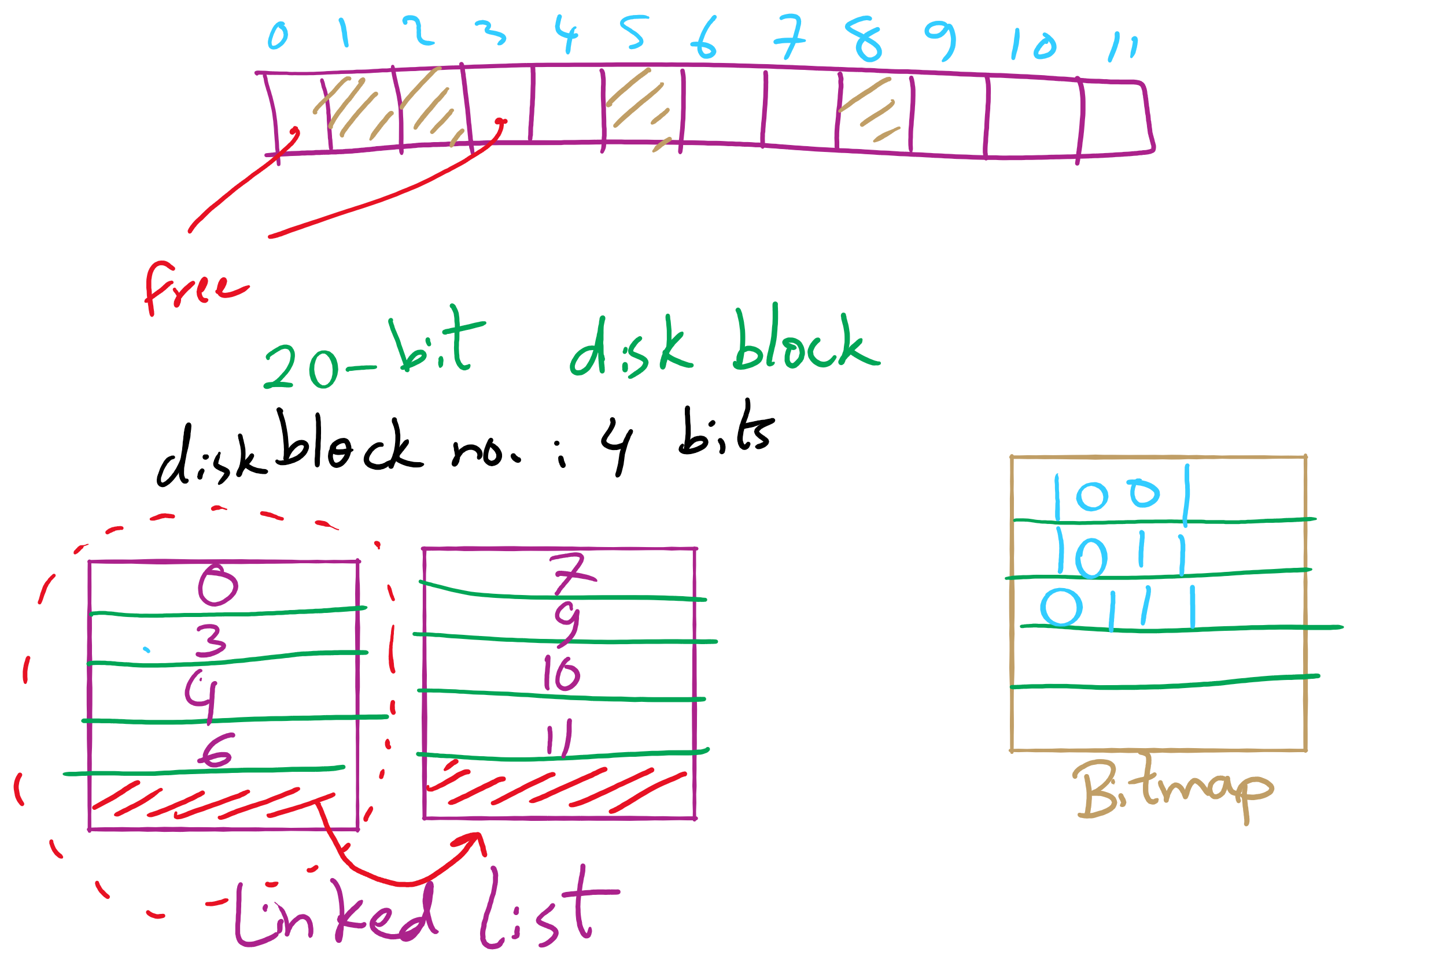
Free Block Tracking Example 2

